Slide 1
DATA ANALYST
Maaz Ahmed

Slide 2
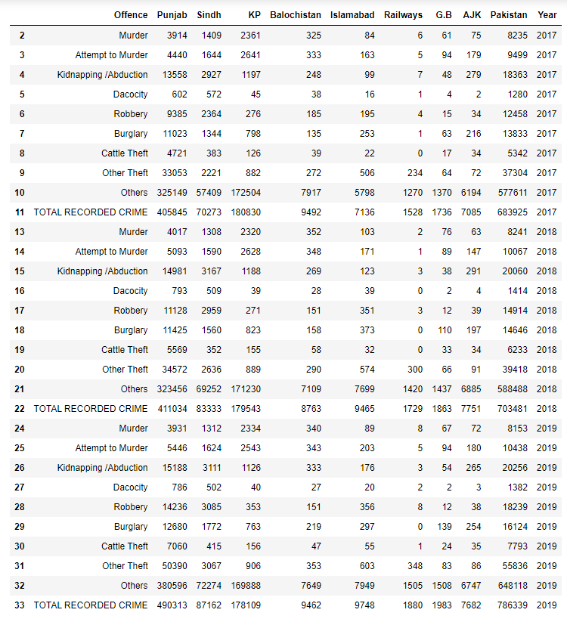
CRIME REPORT DATA

Slide 3
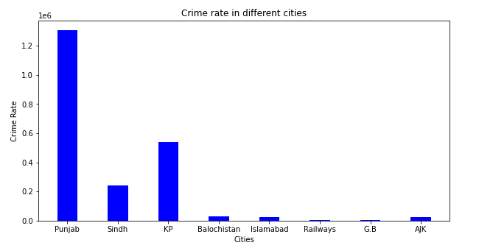
PUNJAB
1307192

Slide 4
RAILWAYS
5137

Slide 5
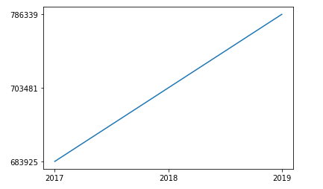
CRIME RATE YEARLY

Slide 6
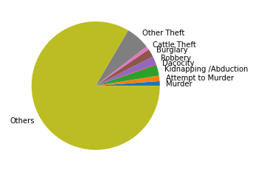
CRIME RATE PER OFFENCE

Slide 7
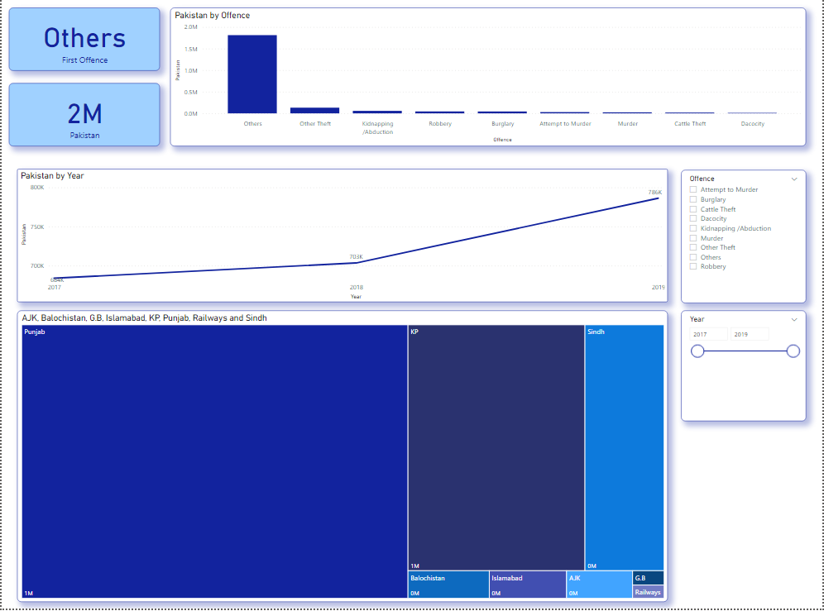
DASHBOARD

Slide 8
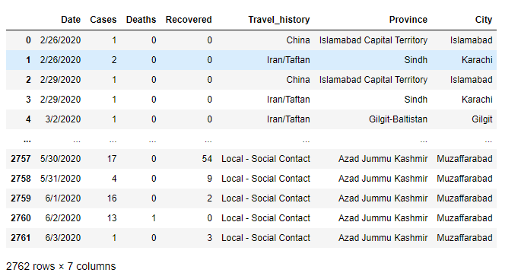
COVID-19 PAKISTAN DATA (2020)

Slide 9
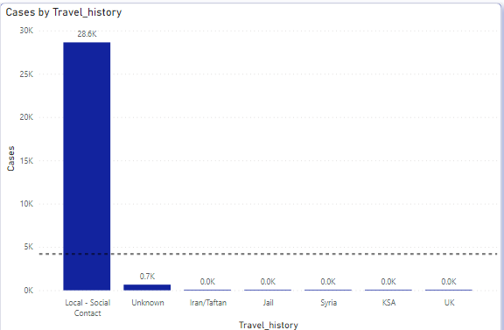
KARACHI
29346

Slide 10
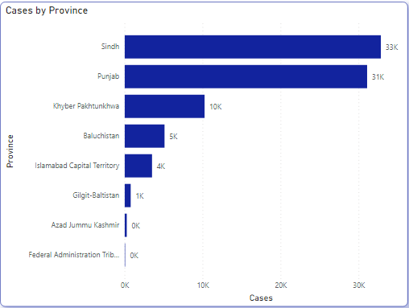
SINDH
32858

Slide 11
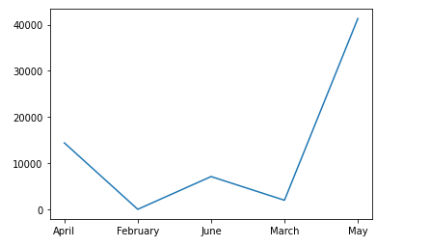
COVID CASES MONTHLY

Slide 12
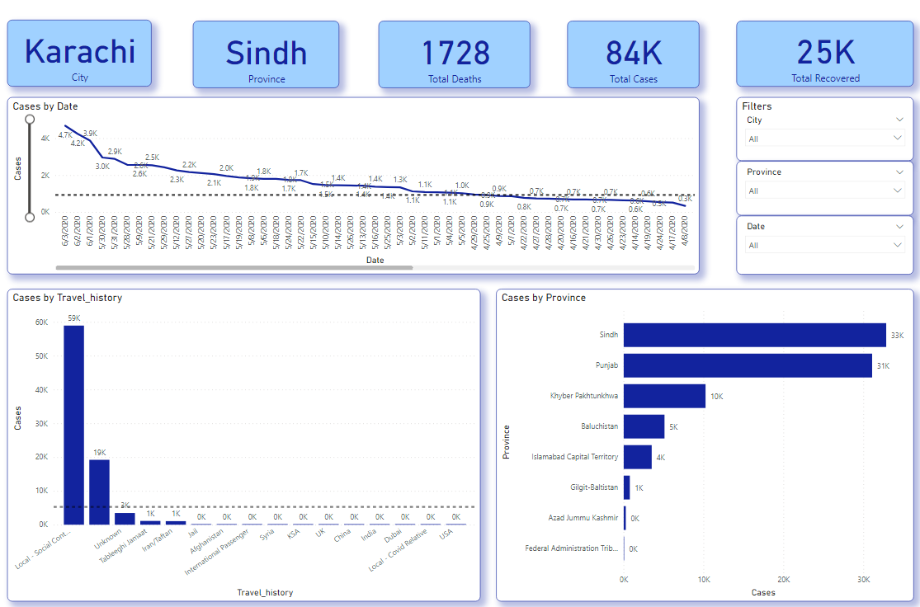
DASHBOARD

Slide 13
THANK YOU!

